Slide 1

ANALYSIS OF WINE QUALITY DATASET USING MACHINE LEARNING
TEAM MEMBERS:
(GROUP-9)
P. GeethaMounika
K.SAHITHI
S.ALEKHYA

Slide 2
CONTENT:
PAGE NO. | CONTENT
3 | BACKGROUND,OBJECTIVE,PATH
4 | DATASET
5-6 | DATA CLEANING
7-9 | EDA
10-17 | MACHINE LEARNING ALGORITHMS REGRESSION
18 | OBSERVATION
19-26 | CLASSIFICATION
27-30 | OBSEVATIONS,CONCLUSION,APPENDIX AND APPLICATIONS.

Slide 3
BACKGROUND:
Wine quality depends on the vinification process and the geographical origin of the grapes but also highly relies on the varietal composition of the grape must; for this reason, wine traceability is important in relation to quality control and consumer information.
OBJECTIVE:
Predict whether a wine is of good or bad quality based on factors such as chemical composition and other relevant attributes.
PATH:
Team followed a Machine Learning algorithm development process.

Slide 4
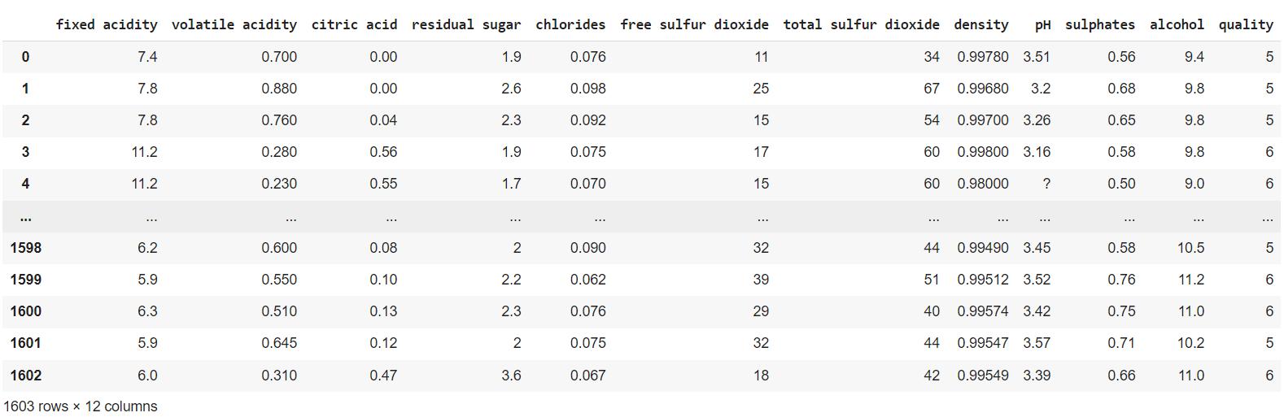
DAT ASET:

Slide 5
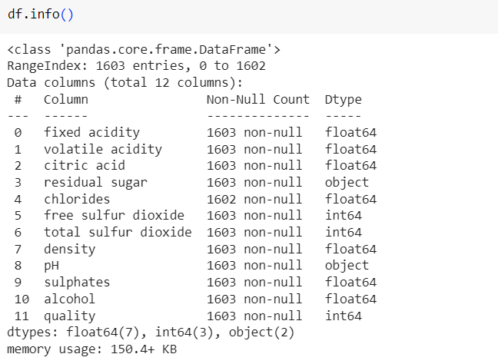
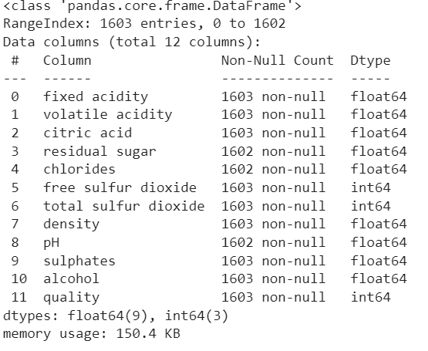
DATA CLEANING:
CONVERTING OBJECT TYPE INTO FLOAT TYPE

Slide 6
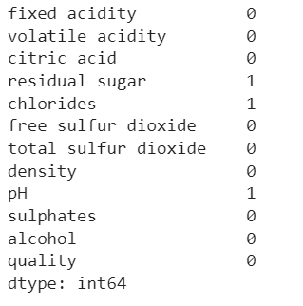
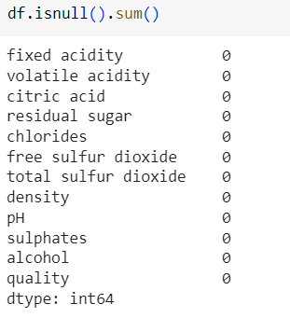
IDENTIFYING NULL VALUES AND REPLACING THEM

Slide 7
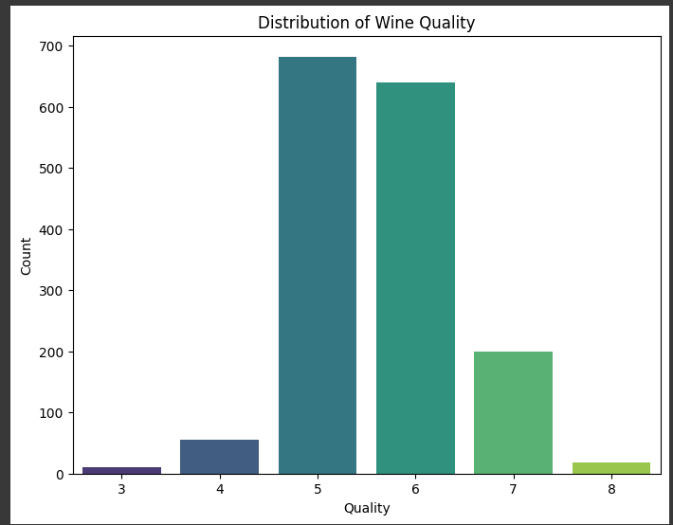
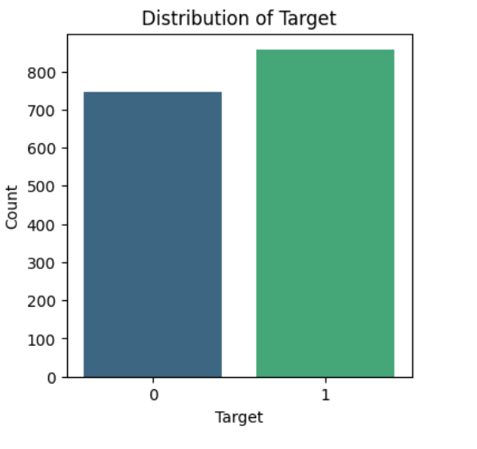
EXPLORATORY DATA ANALYSIS
REGRESSION
CLASSIFICATION

Slide 8
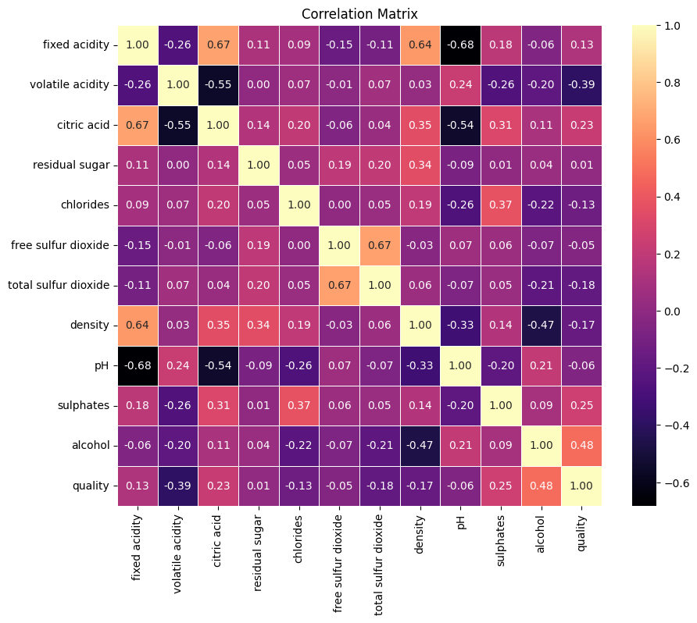
HEAT MAP

Slide 9
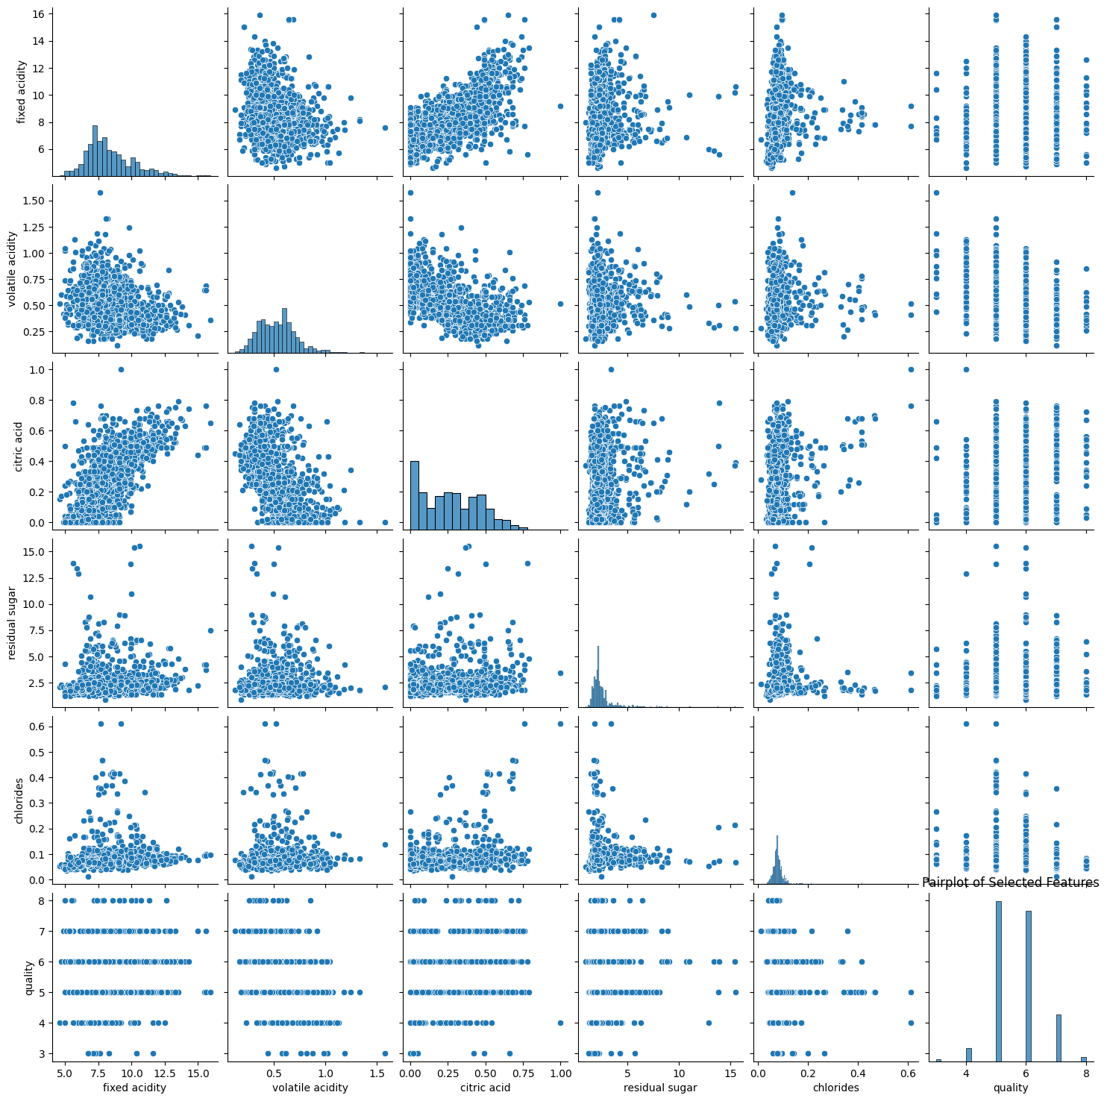
SCATTERPLOT

Slide 10
MACHINE LEARNING
ALOGRITHMS
REGRESSION

Slide 11
80-20 RATIO
ALGORITHMS | MSE | MAPE
Linear Regression | 0.42 | 9.26%
KNN Regression | 0.55 | 10.28%
Decision Tree Regression | 0.59 | 8.67%
Random Forest Regression | 0.33 | 7.79%
Support Vector Regression | 0.49 | 9.82%
Gradient navie bayes Regression | 0.68 | 9.78%
Gradient boosting regressor | 0.37 | 8.63%
Adaboost | 0.38 | 9.14%
XGboost | 0.35 | 8.11%

Slide 12
75-35 RATIO
ALGORITHMS | MSE | MAPE
Linear Regression | 0.42 | 9.26%
KNN Regression | 0.56 | 10.16%
Decision Tree Regression | 0.67 | 9.56%
Random Forest Regression | 0.35 | 7.95%
Support Vector Regression | 0.50 | 10.06%
Gradient Navie bayes Regression | 0.64 | 9.51%
Gradient boosting regressor | 0.39 | 8.86%
Adaboost | 0.40 | 9.37%
XGboost | 0.38 | 8.44%

Slide 13
70-30 RATIO
ALGORITHMS | MSE | MAPE
Linear Regression | 0.48 | 9.99%
KNN Regression | 0.56 | 10.83%
Decision Tree Regression | 0.64 | 9.28%
Random Forest Regression | 0.39 | 8.70%
Support Vector Regression | 0.59 | 11.15%
Gradient Navie bayes Regression | 0.83 | 11.56%
Gradient boosting regressor | 0.43 | 9.59%
Adaboost | 0.46 | 10.26%
XGboost | 0.41 | 9.08%

Slide 14
OVERALL REGRESSION PERFORMANCE METRICS
ALGORITHMS | 70-30(MAPE) | 75-35(MAPE) | 80-20(MAPE)
Linear Regression | 9.99% | 9.26% | 9.26%
KNN Regression | 10.83% | 10.16% | 10.28%
Decision Tree Regression | 9.28% | 9.56% | 8.67%
Random Forest Regression | 8.70% | 7.95% | 7.79%
Support Vector Regression | 11.15% | 10.06% | 9.82%
Gradient navie bayes Regression | 11.56% | 9.51% | 9.78%
Gradient boosting regressor | 9.59% | 8.86% | 8.63%
Adaboost | 10.26% | 9.37% | 9.14%
XGboost | 9.08% | 8.44% | 8.11%

Slide 15
NEURAL NETWORK
70-30 RATIO
SPLIT RATIO | ARCHITECTURE | EPOCHS | OPTIMIZER | MSE | MAPE
70-30 | 64, 32, 1 | 20 | ADAM | 0.82 | 13.46%
70-30 | 128,64,32,1 | 20 | ADAM | 0.47 | 9.93%
70-30 | 64, 32, 1 | 50 | ADAM | 0.54 | 10.80%
70-30 | 128, 64, 32, 1 | 50 | ADAM | 0.59 | 10.64%
70-30 | 64, 32, 1 | 20 | SGD | 0.57 | 11.48%
70-30 | 128, 64, 32, 1 | 20 | SGD | 0.62 | 11.84%
70-30 | 64, 32, 1 | 50 | SGD | 0.50 | 9.91%
70-30 | 128, 64, 32, 1 | 50 | SGD | 1.28 | 16.93%

Slide 16
75-25 RATIO
SPLIT RATIO | ARCHITECTURE | EPOCHS | OPTIMIZER | MSE | MAPE
75-25 | 64, 32, 1 | 20 | ADAM | 0.55 | 9.98%
75-25 | 128, 64, 32, 1 | 20 | ADAM | 0.72 | 13.21%
75-25 | 64, 32, 1 | 50 | ADAM | 0.59 | 11.68%
75-25 | 128, 64, 32, 1 | 50 | ADAM | 0.50 | 10.41%
75-25 | 64, 32, 1 | 20 | SGD | 0.43 | 9.88%
75-25 | 128, 64, 32, 1 | 20 | SGD | 3.37 | 29.51%
75-25 | 64, 32, 1 | 50 | SGD | 0.60 | 11.83%
75-25 | 128, 64, 32, 1 | 50 | SGD | 0.48 | 9.74%

Slide 17
80-20 RATIO
SPLIT RATIO | ARCHITECTURE | EPOCHS | OPTIMIZER | MSE | MAPE
80-20 | 64, 32, 1 | 20 | ADAM | 0.66 | 11.80%
80-20 | 128, 64, 32, 1 | 20 | ADAM | 0.59 | 11.49%
80-20 | 64, 32, 1 | 50 | ADAM | 0.46 | 9.63%
80-20 | 128, 64, 32, 1 | 50 | ADAM | 0.42 | 9.01%
80-20 | 64, 32, 1 | 20 | SGD | 0.65 | 12.21%
80-20 | 128, 64, 32, 1 | 20 | SGD | 0.42 | 9.43%
80-20 | 64, 32, 1 | 50 | SGD | 0.41 | 8.80%
80-20 | 128, 64, 32, 1 | 50 | SGD | 0.40 | 8.74%

Slide 18
OBSERVATIONS
We observed that the train test ratio 80-20 performed slightly better than other ratios.
We also observed that among the all machine learning algorithms the Random forest is giving us the best results , as the MAPE is minimum.
We observed that in most of the cases the KNN Regressor is giving the high MAPE value. A higher MAPE indicates a less accurate forecasting model, so it is not better in terms of predictive performance.
A low MAPE indicates that the percentage difference between predicted and actual values is small, suggesting high accuracy in forecasting or prediction models.
Among all the train-test split ratios for neural network the 80-20 ratio is giving us the best results , as the MAPE value is minimal for all different parameters.

Slide 19
CLASSIFICATION

Slide 20
80-20 RATIO
ALGORITHMS | ACCURACY
Logistic Regression | 69.78%
Decision Tree Classifier | 70.72%
Random Forest Classifier | 80.37%
Gradient Boosting Classifier | 76.95%
Support Vector Classifier | 61.99%
KNN Classifier | 63.24%
Gaussian NB Classifier | 71.03%

Slide 21
75-25 RATIO
ALGORITHMS | ACCURACY
Logistic Regression | 71.32%
Decision Tree Classifier | 74.31%
Random Forest Classifier | 79.30%
Gradient Boosting Classifier | 75.06%
Support Vector Classifier | 62.09%
KNN Classifier | 65.34%
Gaussian NB Classifier | 71.57%

Slide 22
70-30 RATIO
ALGORITHMS | ACCURACY
Logistic Regression | 71.10%
Decision Tree Classifier | 68.61%
Random Forest Classifier | 80.25%
Gradient Boosting Classifier | 75.47%
Support Vector Classifier | 58.84%
KNN Classifier | 64.45%
Gaussian NB Classifier | 70.48%

Slide 23
OVERALL ACCURACIES FOR VARIOUS CLASSIFICATION MODELS
ALGORITHMS | 70-30 | 75-25 | 80-20
Logistic Regression | 71.10% | 71.32% | 69.78%
Decision Tree Classifier | 68.61% | 74.31% | 70.72%
Random Forest Classifier | 80.25% | 79.30% | 80.37%
Gradient Boosting Classifier | 75.47% | 75.06% | 76.95%
Support Vector Classifier | 58.84% | 62.09% | 61.99%
KNN Classifier | 64.45% | 65.34% | 63.24%
Gaussian NB Classifier | 70.48% | 71.57% | 71.03%

Slide 24
NEURAL NETWORK
80-20 RATIO
SPLIT RATIO | ARCHITECTURE | EPOCHS | LEARNING RATE | OPTIMIZER | ACCURACY
80-20 | 64-32-1 | 10 | 0.01 | ADAM | 62.93
80-20 | 64-32-1 | 20 | 0.01 | ADAM | 67.93
80-20 | 64-32-1 | 30 | 0.01 | ADAM | 69.16
80-20 | 64-32-1 | 50 | 0.01 | ADAM | 67.29
80-20 | 128-64-32-1 | 10 | 0.01 | ADAM | 66.98
80-20 | 128-64-32-1 | 20 | 0.01 | ADAM | 62.93
80-20 | 128-64-32-1 | 30 | 0.01 | ADAM | 66.67
80-20 | 128-64-32-1 | 50 | 0.01 | ADAM | 70.09
80-20 | 64-32-1 | 10 | 0.01 | SGD | 59.19
80-20 | 64-32-1 | 20 | 0.01 | SGD | 57.63
80-20 | 64-32-1 | 30 | 0.01 | SGD | 61.06
80-20 | 64-32-1 | 50 | 0.01 | SGD | 60.75
80-20 | 128-64-32-1 | 10 | 0.01 | SGD | 62.62
80-20 | 128-64-32-1 | 20 | 0.01 | SGD | 63.55
80-20 | 128-64-32-1 | 30 | 0.01 | SGD | 62.31
80-20 | 128-64-32-1 | 50 | 0.01 | SGD | 52.65
80-20 | 64-32-1 | 10 | 0.01 | RMSprop | 65.42
80-20 | 64-32-1 | 20 | 0.01 | RMSprop | 62.31
80-20 | 64-32-1 | 30 | 0.01 | RMSprop | 58.57
80-20 | 64-32-1 | 50 | 0.01 | RMSprop | 65.73
80-20 | 128-64-32-1 | 10 | 0.01 | RMSprop | 58.57
80-20 | 128-64-32-1 | 20 | 0.01 | RMSprop | 60.44
80-20 | 128-64-32-1 | 30 | 0.01 | RMSprop | 58.88
80-20 | 128-64-32-1 | 50 | 0.01 | RMSprop | 67.91

Slide 25
70-30 RATIO
SPLIT RATIO | ARCHITECTURE | EPOCHS | LEARNING RATE | OPTIMIZER | ACCURACY
70-30 | 64-32-1 | 10 | 0.01 | ADAM | 66.32
70-30 | 64-32-1 | 30 | 0.01 | ADAM | 65.49
70-30 | 64-32-1 | 50 | 0.01 | ADAM | 68.40
70-30 | 128-64-32-1 | 10 | 0.01 | ADAM | 61.12
70-30 | 128-64-32-1 | 30 | 0.01 | ADAM | 67.98
70-30 | 128-64-32-1 | 50 | 0.01 | ADAM | 54.05
70-30 | 64-32-1 | 10 | 0.01 | SGD | 50.94
70-30 | 64-32-1 | 30 | 0.01 | SGD | 57.38
70-30 | 64-32-1 | 50 | 0.01 | SGD | 51.35
70-30 | 128-64-32-1 | 10 | 0.01 | SGD | 59.67
70-30 | 128-64-32-1 | 30 | 0.01 | SGD | 60.50
70-30 | 128-64-32-1 | 50 | 0.01 | SGD | 60.71
70-30 | 64-32-1 | 10 | 0.01 | RMSprop | 59.67
70-30 | 64-32-1 | 30 | 0.01 | RMSprop | 56.96
70-30 | 64-32-1 | 50 | 0.01 | RMSprop | 64.24
70-30 | 128-64-32-1 | 10 | 0.01 | RMSprop | 62.79
70-30 | 128-64-32-1 | 30 | 0.01 | RMSprop | 53.64
70-30 | 128-64-32-1 | 50 | 0.01 | RMSprop | 59.88

Slide 26
75-25 RATIO
SPLIT RATIO | ARCHITECTURE | EPOCHS | LEARNING RATE | OPTIMIZER | ACCURACY
75-25 | 64-32-1 | 10 | 0.01 | ADAM | 60.71
75-25 | 64-32-1 | 30 | 0.01 | ADAM | 65.90
75-25 | 64-32-1 | 50 | 0.01 | ADAM | 69.65
75-25 | 128-64-32-1 | 10 | 0.01 | ADAM | 61.33
75-25 | 128-64-32-1 | 30 | 0.01 | ADAM | 67.15
75-25 | 128-64-32-1 | 50 | 0.01 | ADAM | 70.27
75-25 | 64-32-1 | 10 | 0.01 | SGD | 59.88
75-25 | 64-32-1 | 30 | 0.01 | SGD | 50.94
75-25 | 64-32-1 | 50 | 0.01 | SGD | 59.25
75-25 | 128-64-32-1 | 10 | 0.01 | SGD | 52.39
75-25 | 128-64-32-1 | 30 | 0.01 | SGD | 55.93
75-25 | 128-64-32-1 | 50 | 0.01 | SGD | 59.88
75-25 | 64-32-1 | 10 | 0.01 | RMSprop | 60.08
75-25 | 64-32-1 | 30 | 0.01 | RMSprop | 66.11
75-25 | 64-32-1 | 50 | 0.01 | RMSprop | 62.37
75-25 | 128-64-32-1 | 10 | 0.01 | RMSprop | 50.94
75-25 | 128-64-32-1 | 30 | 0.01 | RMSprop | 60.91
75-25 | 128-64-32-1 | 50 | 0.01 | RMSprop | 64.66

Slide 27
OBSERVATIONS
We observed that the train test ratio 80-20 performed slightly better than other
ratios
We also observed that among the all machine learning algorithms the Random forest is giving us the best Accuracy, i.e 80%.
We observed that in most of the cases the SVC Classifier is giving the low Accuracy. Low accuracy in a classification algorithm indicates a higher rate of incorrect predictions, diminishing the model's effectiveness and potentially leading to unreliable decision-making.
High accuracy in a classification algorithm reflects a low rate of incorrect predictions
Among all the train-test split ratios for neural network the 75-25 ratio is giving us the best results , as it is giving high accuracy. Highest accuracy is achieved with the Adam optimizer with learning rate 0.01 and at 50 epochs.

Slide 28
CONCLUSION:
Among Regression and Classification, Classification model is best fit for this wine quality-red dataset
For Regression, Random forest is the giving low MAPE value. As we know, A low MAPE indicates that the percentage difference between predicted and actual values is small, suggesting high accuracy in forecasting or prediction models.
For Classification also Random forest is giving High Accuracy. As we know Low accuracy in a classification algorithm indicates a higher rate of incorrect predictions.
In case of both Regression and classification models, RANDOM FOREST algorithm is maintaining high accuracy in terms of classification and low MAPE in terms of regression

Slide 29
APPLICATIONS:
Wine Production: Winemakers use quality assessments to monitor and improve their production processes. Understanding the factors that contribute to high-quality wine helps in refining cultivation, harvesting, and fermentation methods.
Consumer Choices: Consumers often rely on wine quality ratings and reviews to make informed purchasing decisions. These assessments can influence market trends and consumer preferences.
Pricing Strategies: Wineries may set prices based on the perceived quality of their wines. High-quality wines may command higher prices in the market, contributing to revenue and brand image.

Slide 30
APPENDIX:
REGRESSION COLLAB NOTEBOOK
CLASSIFICATION COLLAB NOTEBOOK
https://colab.research.google.com/drive/1tXxY2twQYn9oktXZxvReI1kIPuMmRwV4?usp=drive_link
https://colab.research.google.com/drive/1ttcrkifHSi4q6DP-QwhzbXYJ_D3D93qI?usp=drive_link

Slide 31
THANK YOU

